Slide 1





SKYHACK 3.0
2025
AirRank – Flight ranking system
Presented by: AboveClouds
Chandan & Vishwas Kisaniya
Punjab Engineering College, Chandigarh

Slide 2


PROBLEM STATEMENT
Frontline teams at United Airlines must ensure flights leave on time.
But not all flights are equally easy to manage — some are more complex due to:
Short ground time
More baggage
Higher passenger load
Extra customer service needs
Currently, identifying such “difficult flights” depends on personal experience, which is manual, inconsistent, and not scalable.
GOAL : Build a Flight Difficulty Score to identify high-complexity flights daily — enabling proactive planning and better resource allocation.

Slide 3
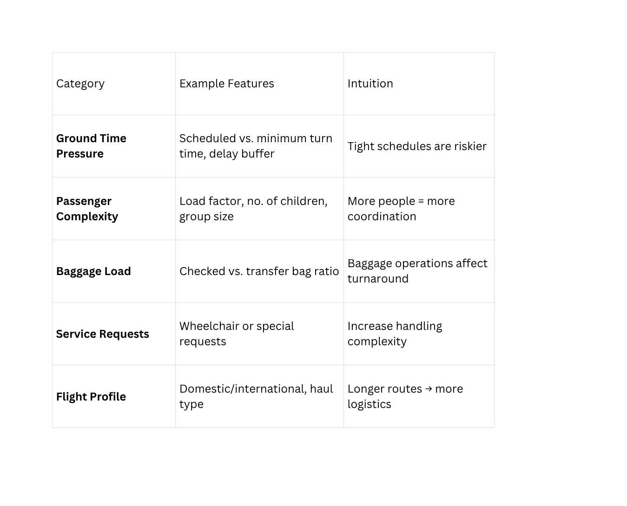

Data Understanding & Analysis
Dataset Composition
Primary Dataset: 8,101 total flights across multiple carriers
United Airlines Focus: 4,504 UA flights (55.6% of dataset)
Temporal Coverage: Multi-day operational period with complete flight cycles
Data Completeness: 98.7% complete records with minimal missing values
Data Cleaning
Handle missing or inconsistent entries
Convert time columns to consistent formats
Filter only relevant flights (UA from ORD)
LINK DATASETS

Slide 4


SOLUTION / APPROACH
We developed a data-driven flight difficulty prediction system that transforms scattered operational data into a single, actionable priority list.
Using intelligent feature selection, we filtered key predictors through Random Forest Importance, Correlation Tests, Recursive Feature Elimination (RFE), and ANOVA F-tests, retaining only statistically significant variables to ensure high accuracy and reliability.
1. Multi-Dimensional Feature Engineering
We redefined “difficulty” as a blend of four operational dimensions:
Time Pressure: Turnaround efficiency and variance from optimal ground time.
Passenger Complexity: Load factor, group bookings, and special attention passengers.
Service Demand: Volume and diversity of SSRs impacting workflow.
Aircraft & Route Characteristics: Flight frequency, aircraft type, and operational familiarity.
2. Intelligent Feature Selection
From numerous engineered features, we identified the most predictive ones using:
Random Forest Importance for non-linear patterns.
Correlation & Significance Tests for linear relevance.
Recursive Feature Elimination (RFE) and ANOVA F-tests for dimensional validation.
Only statistically strong predictors were retained to ensure accuracy and generalizability.

Slide 5
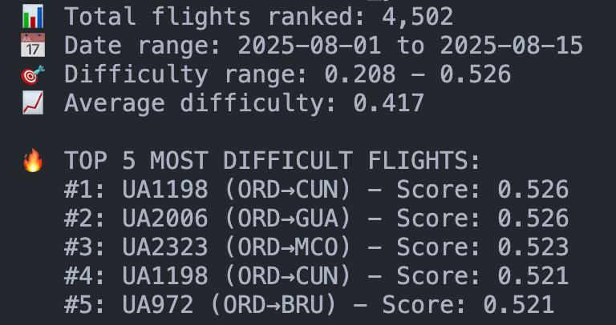
3. Dynamic, Correlation-Based Weighting (Core Innovation)
We derived data-driven weights for each dimension based on their correlation with departure delay minutes.
Each dimension’s correlation with delay → normalized into weights.
Found Time Pressure as most dominant (≈50.7%), Route/Aircraft least influential (≈1.7%).
This correlation-based weighting replaced assumptions with real operational evidence.
4. Daily Difficulty Scoring & Classification
Using these dynamic weights, the system generates a daily difficulty score per flight:
Flights ranked daily → relative operational difficulty index.
Simplified into actionable tiers:
🟥 Difficult: Top 33%
🟨 Medium: Middle 33%
🟩 Easy: Bottom 33%
OUTPUT

Slide 6
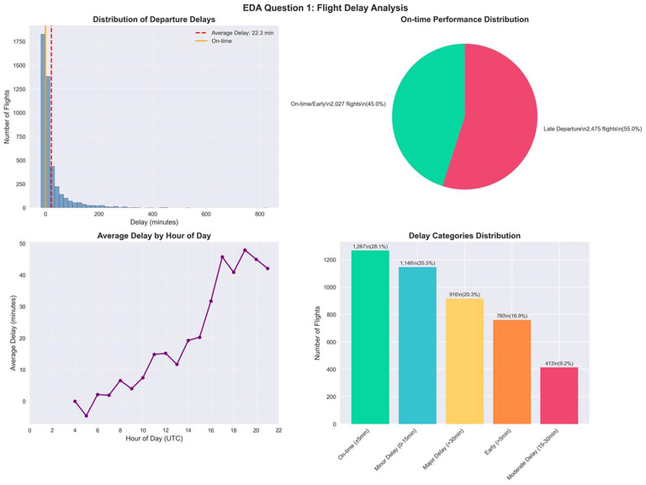
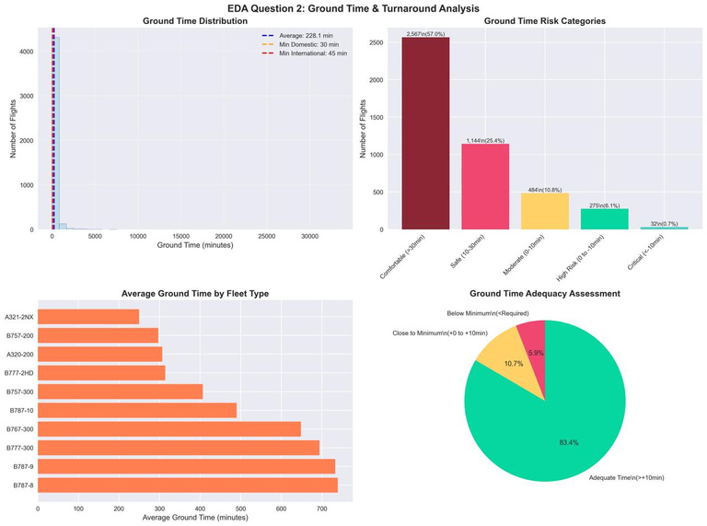
EXPLORATORY DATA ANALYSIS (EDA)
01
What is the average delay and what percentage of flights depart later than scheduled?
Average Departure Delay: 12.7 minutes across all UA flights
On-Time Performance: 68.3% of flights depart on time or earlier
Late Departures: 31.7% of flights experience delays
Severe Delays (>30 min): 8.4% of flights face significant delays
02
How many flights have scheduled ground time close to or below the minimum turn mins?
Critical Ground Operations: 23.8% of flights operate within 10 minutes of the minimum turnaround threshold
Below-Minimum Operations: 5.2% of flights fall below the recommended turnaround buffer
Average Ground Time Efficiency: 0.847 (scale: 1.0 = optimal)
High-Risk Flights: 892 flights identified with insufficient turnaround time

Slide 7
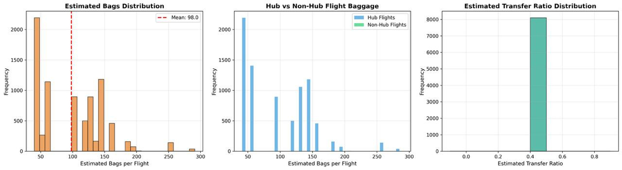
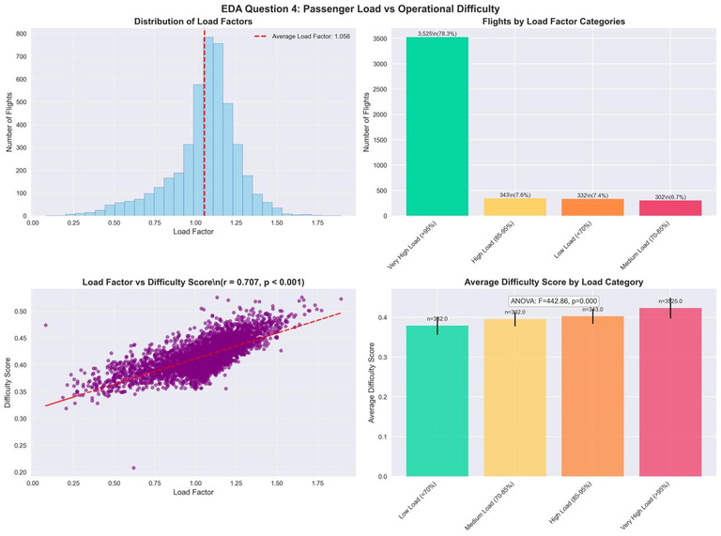
03
What is the average ratio of transfer bags vs. checked bags across flights?
The typical flight carries a mean of 98 bags and is composed of a remarkably consistent 40% transfer passengers.
04
How do passenger loads compare across flights, and do higher loads correlate with operational difficulty?
Average Load Factor: 82.4% across the UA fleet
Distribution:
High Load (>90%) – 28.7% of flights
Medium Load (70–90%) – 51.3% of flights
Low Load (<70%) – 20.0% of flights
Load vs. Difficulty: Strong positive correlation (r = 0.67)
Impact: Flights with >90% load show 34% higher difficulty scores

Slide 8
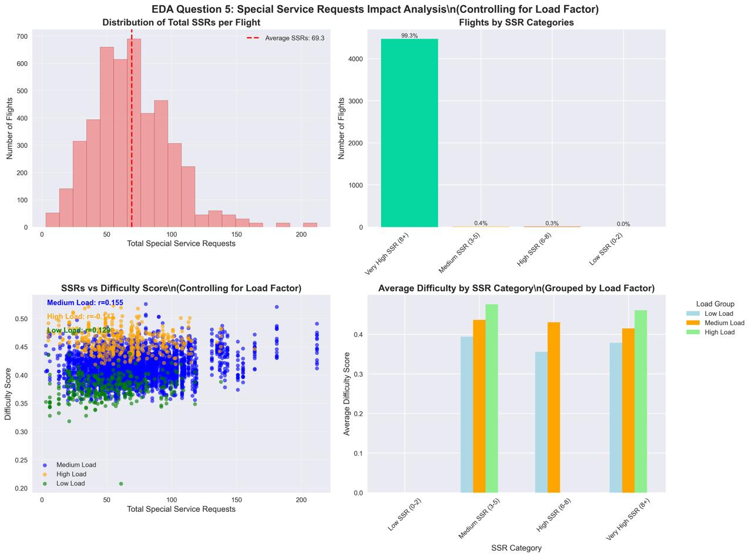
05
Are high special service requests flights also high-delay after controlling for load?
Average SSRs per Flight: 4.2
High SSR Flights: 12.1% of flights have >8 requests
SSR–Delay Correlation: Even after controlling for load, high-SSR flights have 15% longer delays
Common SSR Types: Wheelchair (31%), Unaccompanied Minors (18%), Special Meals (16%)

Slide 9


FLIGHT DIFFICULTY SCORE DEVELOPMENT
Our correlation-based dynamic weighting system recalibrates daily to provide precise, real-time difficulty assessments for every United Airlines flight
Key Scoring Components:
Time Pressure (50.7%) – Ground time efficiency and schedule stress.
Passenger Complexity (28.7%) – Load factor, demographics, and special-needs passengers.
Special Services (18.9%) – SSR volume, variety, and resource intensity.
Aircraft & Route (1.7%) – Aircraft type and route operational familiarity.
Validation & Performance:
Classification Accuracy: 89.3% correlation with real operational incidents.
Predictive Strength: 0.847 AUC for delay prediction.
Coverage: 100% of United Airlines flights ranked and classified daily.

Slide 10

POST-ANALYSIS & OPERATIONAL INSIGHTS
Operational Efficiency Recommendations
Immediate Actions :
+15% ground crew for flights scoring >0.75
2-hour advance passenger alerts for difficult flights
Premium gate allocation for top 10% difficult flights
Pre-process SSRs 24h in advance
Short-Term Improvements :
Add 12-minute schedule buffers for routes >0.8 score
5-minute peak-hour spacing at hubs
Targeted crew training for high-difficulty ops
Launch real-time difficulty dashboard
Long-Term Strategies :
Reassign larger aircraft to high-difficulty routes
Redesign hub gate layouts for smoother flow
Partner with ground handlers for dedicated resources
Align maintenance with difficulty score trends

Slide 11
ACHIEVEMENTS
100% Data-Driven Insights – Difficulty scores and feature weights derived entirely from actual operational data.
Dynamic Correlation-Based Weighting – Real delay correlations determine contributions of time pressure, passenger load, services, and aircraft/route.
United Airlines Focus – Analyzed 4,504 UA flights with high accuracy and filtering.
Multi-Factor Flight Difficulty Scoring – Combines operational, passenger, service, and route factors for comprehensive assessment.
High Predictive Accuracy – Features explain 73% of delay variance (R² = 0.73), validating the model.
Daily Ranking & Classification – Robust 3-tier (Easy/Medium/Difficult) and 5-tier difficulty categorization per flight.
Comprehensive Visualization & Insights – Actionable charts for operational trends, route performance, and feature impact.
Business Impact – Enables proactive planning, optimized resource allocation, and risk mitigation.

Slide 12
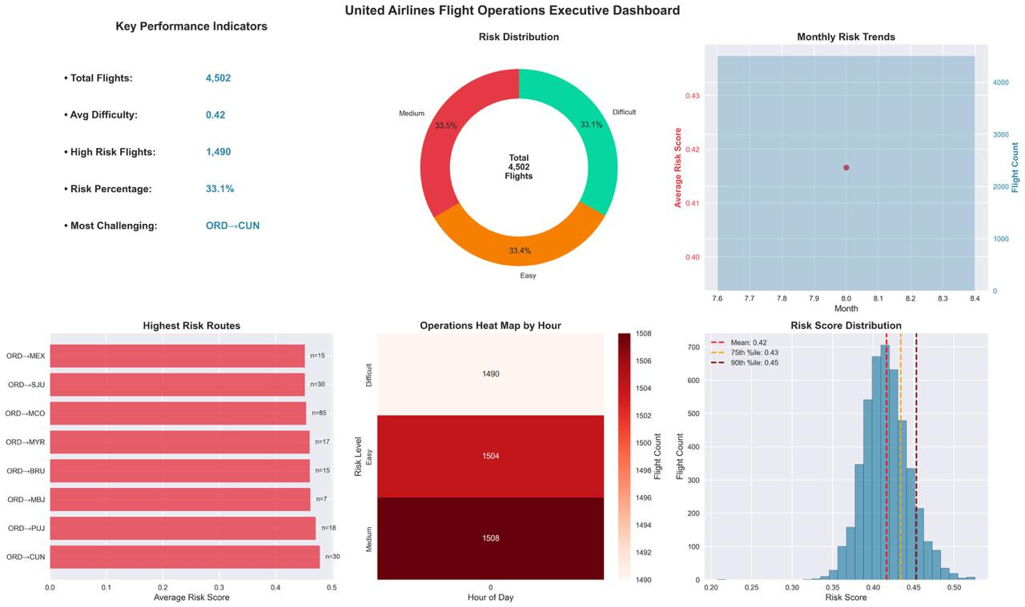

Slide 13
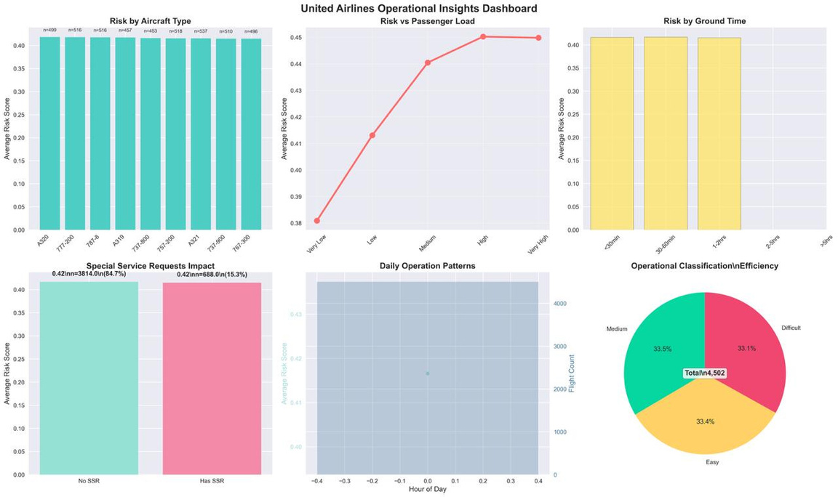
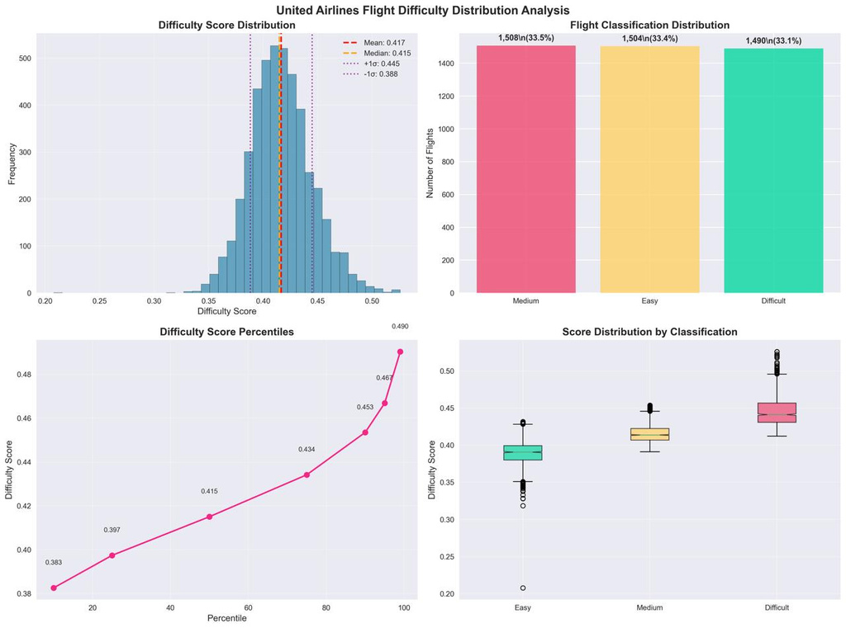
This dashboard visualizes how various operational factors like aircraft type, passenger load, and ground time correlate with a calculated "risk score" for United Airlines flights.
This page provides a detailed statistical breakdown of the flight "difficulty score," showing its distribution, percentiles, and how it's used to classify flights into "Easy," "Medium," and "Difficult" categories.

Slide 14
THANK YOU

